Slide 1

GAYATRI VIDYA PARISHAD
COLLEGE FOR DEGREE AND PG COURSES(A)
(Affiliated to Andhra University | Accredited by NAAC with " B++" Grade | ISO 9001: 2015)
Visakhapatnam-530045.
A Cryptographic Algorithm Based on ASCII and Number System Conversions along with
A Cyclic Mathematical Function
Project By MCA 4th semester
Name : Bendi Satya Pavan
Rollno : PG212202006
Project Guide By
Sir. B. DIVAKAR
ASSISTANT PROFESSOR

Slide 2
CONTENTS
Abstract
Functional Requirements
Non-Functional Requirements
Use-case diagram for Sender and Receiver
Sequence diagram for Sender
Sequence diagram for Receiver
State chart diagram for Sender
State chart diagram for Receiver
Conclusion

Slide 3
ABSTRACT
Data encryption and decryption in an efficient manner are the challenging aspects of modern information theory. In this algorithm, the plaintext to be encrypted is converted into unprintable characters. For encryption, a different technique is applied based on ASCII and number system conversions, which makes this algorithm different from others. First, each character of the plaintext and secret key is converted into its equivalent ASCII (decimal). Then, using some matrix manipulations on the decimal, representation of each character is transformed to 4 unprintable characters. After that, every unprintable character in the intermediate cipher text is further converted into a different unprintable character using a cyclic mathematical function. Performing three steps of processing, the final encrypted message is produced that gives higher level of security.
.

Slide 4
Functional Requirements
Encryption
Input : Plain text,
Keys(s) : Random Key value.
Output : Cipher text.
Decryption
Input : Cipher text,
Key(s) : Get Key .
Output : Plain text.

Slide 5
Functional Requirements
Hardware Requirements
Processor : Intel i3 & Above
RAM : 4 GB
Hard disk : 500 GB
Keyboard : Standard 102 Keys
Mouse : Standard
Software Requirements:
Operating system : Windows 7 & Above
Front-end/GUI tool : Python IDLE 3.10.4.
Programming language : Python Programming

Slide 6
Non-Functional Requirements
Usability: The GUI of this system provides easy access to the user and user can get best results for the given input.
Supportability: System is implemented using Python 3.8.3 IDLE
Performance: It display the correct result based on the output for all possible correct inputs at all times when the computer is in proper condition.
Reliability: This system will perform its intended function adequately for a specific period of time.
Maintainability: This system can adapt any technology and can detect errors.
Portability: This system can work on windows operating system environment with minimal changes.

Slide 7
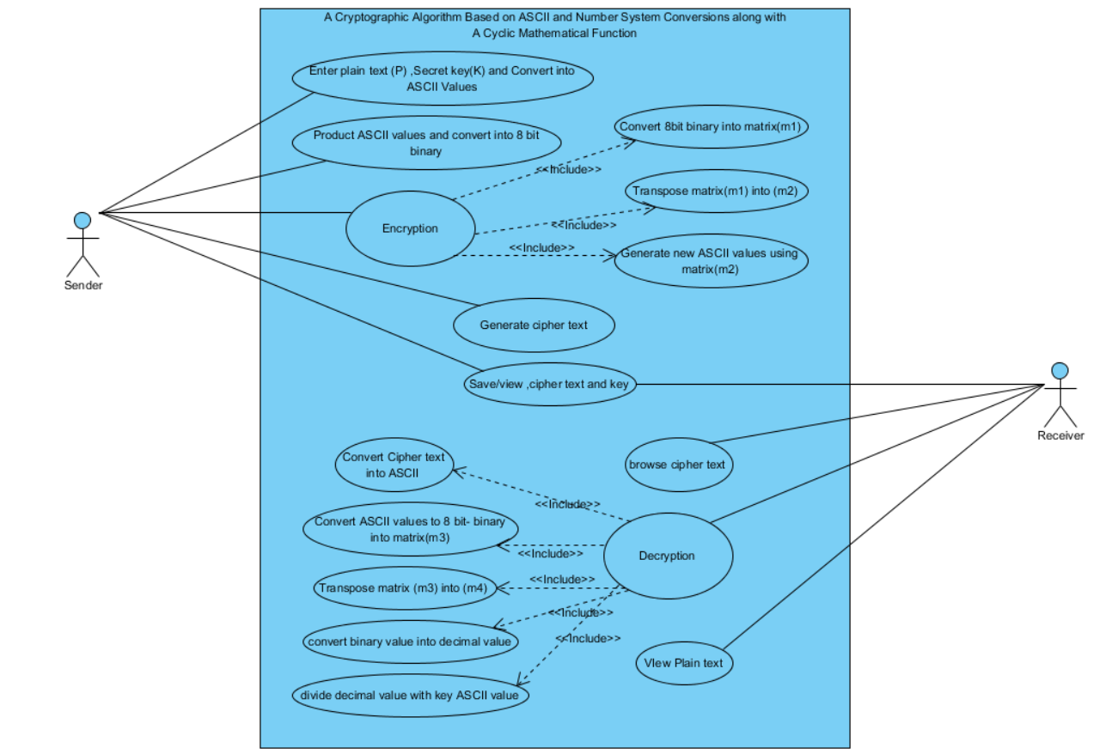
Use-case diagram for Sender and Receiver

Slide 8
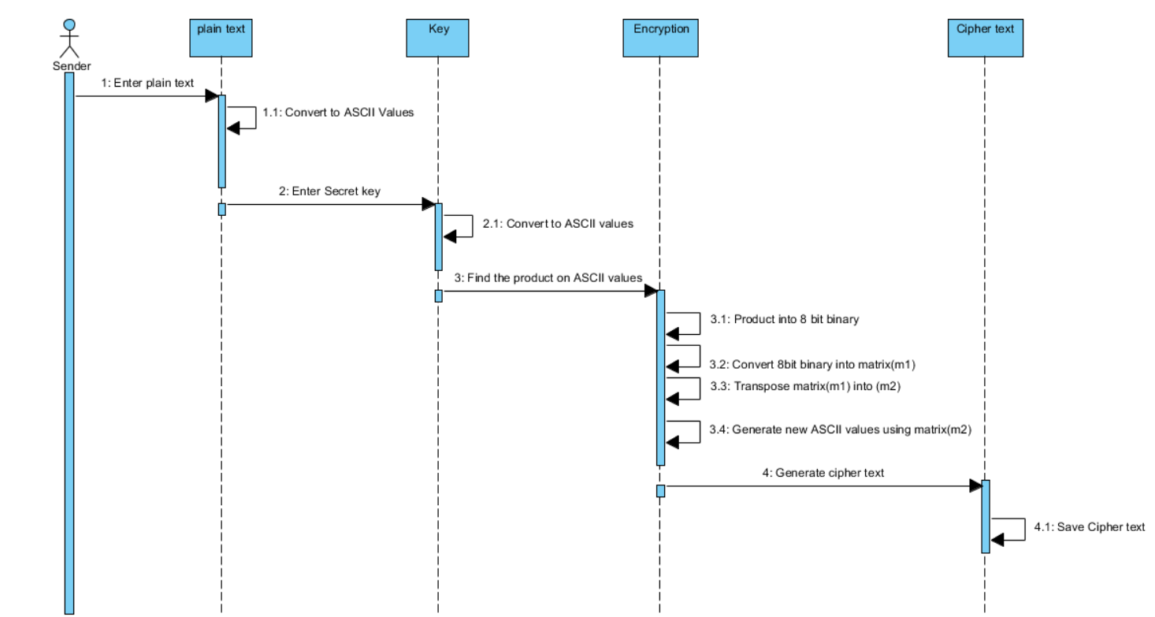
Sequence diagram for Sender

Slide 9
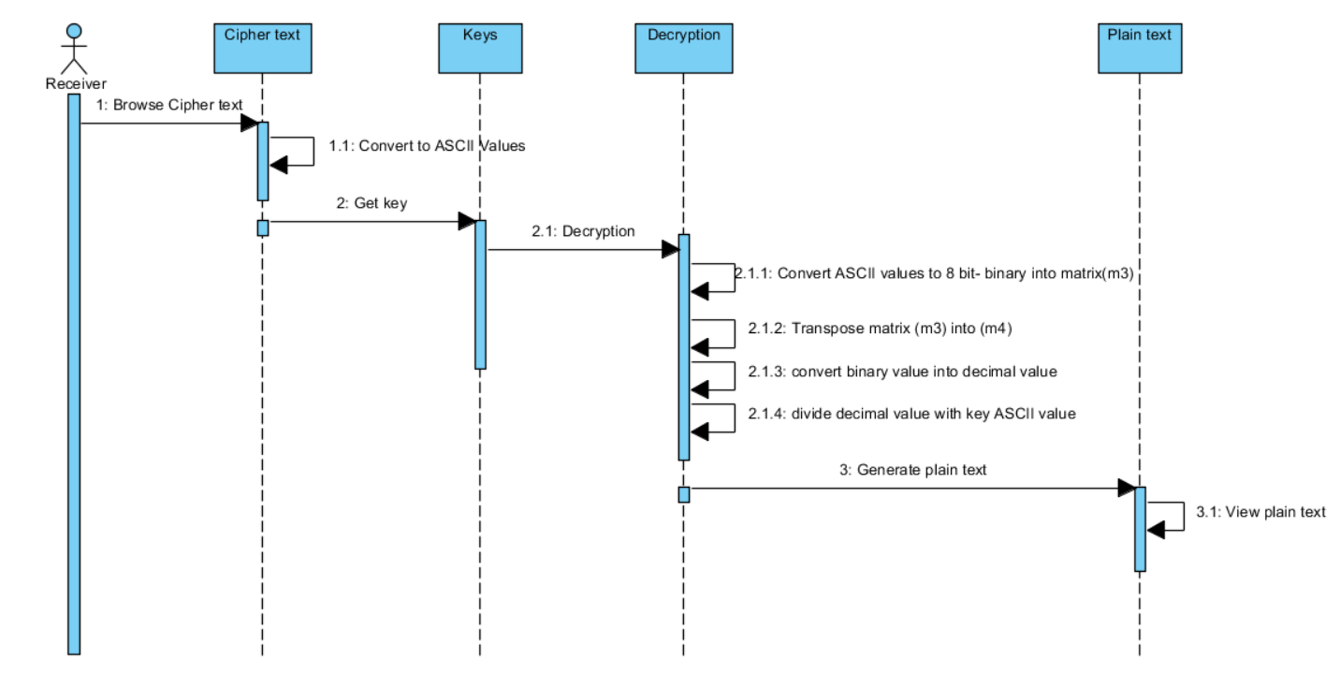
Sequence diagram for Receiver

Slide 10
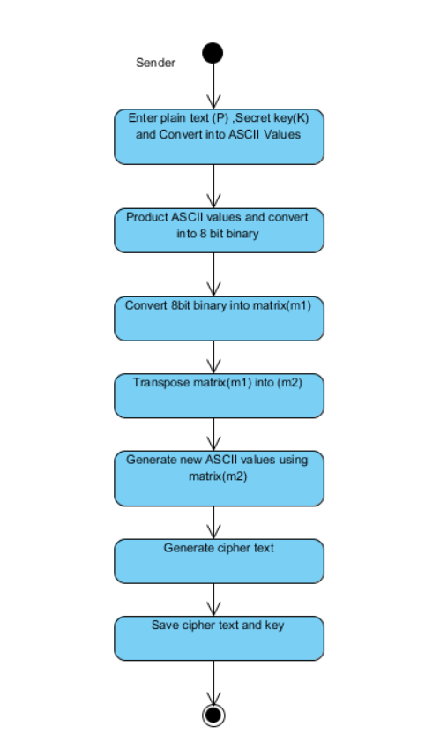
State chart diagram for Sender

Slide 11
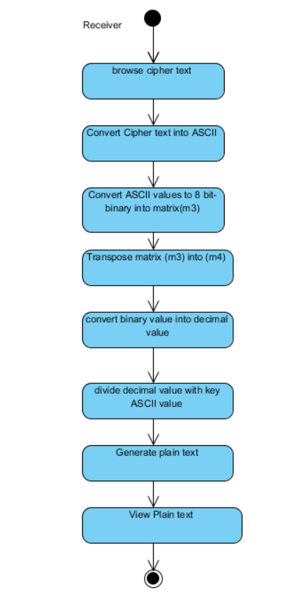
State chart diagram for Receiver

Slide 12
CONCLUSION
To ensure higher security and to hide data in effective way the proposed algorithm contributes greatly. Here, we present an algorithm which is based on ASCII conversion and number system conversion and a cyclic mathematical function. This algorithm not only encrypts the data but also hides the data which gives more security. In future we will try to increase the security technique and implement some real time security system and try to add steganography with the system.

Slide 13


